Slide 1
Intro to Python
Day 1, Afternoon Session | NumPy
Instructor: Ian Chu Te

Slide 2

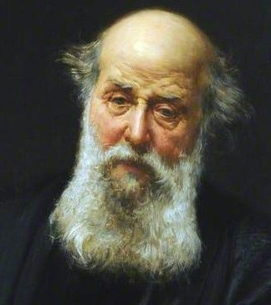
Mathematics is the music of reason
James Joseph Sylvester

Slide 3
Numerical Python (NumPy)

Slide 4


Numerical Python (NumPy)
NumPy is a Python library for numerical analysis
It comes pre-installed with Anaconda
Python

Slide 5
Importing libraries

Slide 6
Importing libraries
Python libraries are not imported by default
If you want to use a Python library, you need to import it
Basic import
import libraryname
import numpy
Importing with alias
import libraryname as alias
import numpy as np

Slide 7
NumPy vs Python

Slide 8
NumPy vs Python
NumPy | Python
Fast, parallel computation (vectorized operations) | Sequential computation (for-loop, while-loop)
Broadcasting operations (matrix addition, matrix multiplication, etc.) | One-by-one operations (for-loop within for-loop)
np.array | List
np.array | List of lists

Slide 9
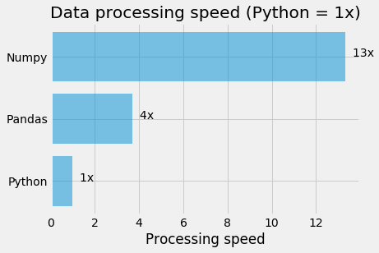
NumPy is faster!

Slide 10
np.array

Slide 11
Element
An element is simply a number
Example: age is a number

Slide 12

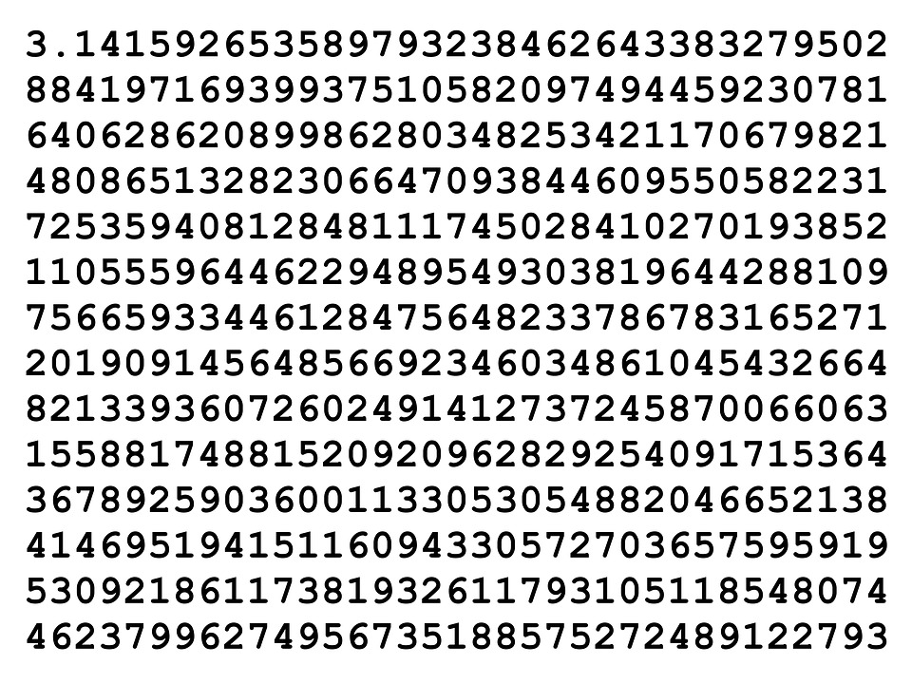
Element
An element is simply a number
Example: pi is an element

Slide 13
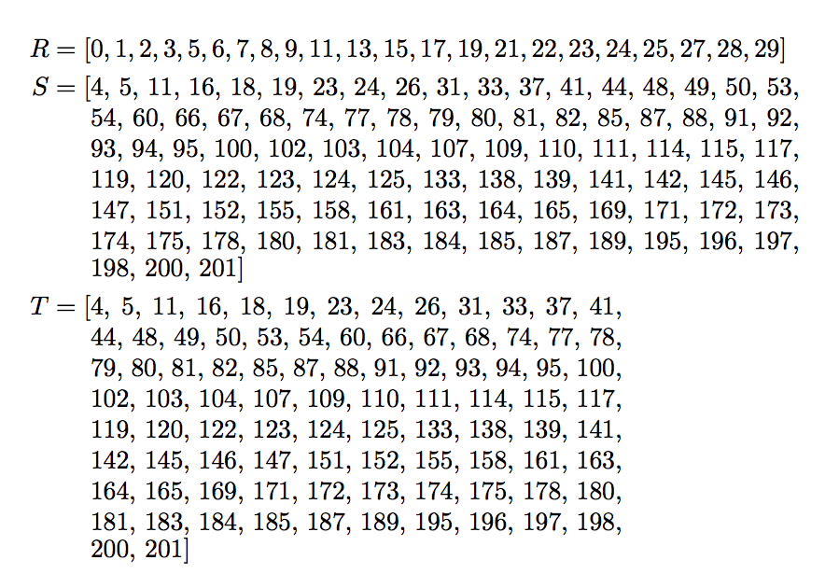
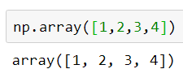
Vector
A vector is a list of n elements
A vector can be though of as a 1-dimensional matrix
Example: a list of numbers is a vector

Slide 14
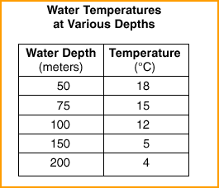
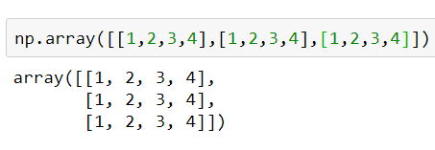
Two-dimensional Matrix
A two-dimensional matrix is a vector of vectors
Example: a data table is a two-dimensional matrix

Slide 15
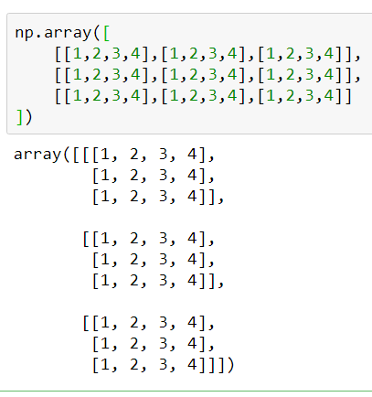

Three-dimensional Matrix
A three-dimensional matrix is a vector of vectors of vectors
Example:
a colored image (length, width, color channel - RGBA)

Slide 16
np.array
np.array is the central data type of NumPy
np.array can represent any n-dimensional matrix
There are other data types (e.g. sparse matrices) but most of the time np.array is enough

Slide 17
np.array Indexing
np.array can be indexed using the bracket operator []
a[n1,n2,n3,…]
a = np.array([1,2,3,4])
a[0]
a = np.array([[1,2],[3,4]])
a[0,1]
a = np.array([[[1,2],[3,4]],[[5,6],[7,8]]])
a[0,0,0]

Slide 18
np.array Boolean Indexing
np.array can also be indexed using Boolean conditions
a[condition]
a = np.array([1,2,3,4])
greater_than_two = a>2
a[greater_than_two]
a = np.array([1,2,3,4,5,6,7,8])
greater_than_two = a>2
less_than_seven = a<7
a[greater_than_two & less_than_seven]

Slide 19
NumPy Boolean operators
& - and
| - or
~ - not
IMPORTANT: enclose all your comparison conditions in parentheses
Wrong: a>1 & a<5
Correct: (a>1) & (a<5)

Slide 20
np.array Slicing
np.array can be sliced using the bracket operator [ ]
Slicing with start and stop
a[start:stop]
a = np.array([1,2,3,4,5,6,7,8])
a[2:4]
Slicing with start only
a[start:]
a = np.array([1,2,3,4,5,6,7,8])
a[2:]
Slicing with end only
a[:end]
a = np.array([1,2,3,4,5,6,7,8])
a[:2]
Getting columns
a[:,column]
a = np.array([[1,2,3,4],[5,6,7,8],[9,10,11,12]])
a[:,0]
Getting group of columns
a[:,column_start:column_end]
a = np.array([[1,2,3,4],[5,6,7,8],[9,10,11,12]])
a[:,0:2]

Slide 21
np.array Operations
np.array supports all common arithmetic operations
Element-wise arithmetic
np.array([1,2]) + np.array([1,2])
np.array([1,2]) - np.array([1,2])
np.array([1,2]) * np.array([1,2])
np.array([1,2]) / np.array([1,2])
Broadcasted arithmetic
the smaller array is “broadcast” across the larger array so that they have compatible shapes
np.array([[1,2],[3,4]]) - np.array([1,2])

Slide 22
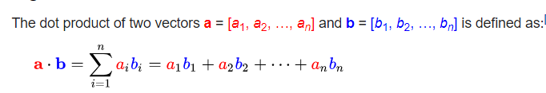
Dot product
Dot product is one of the most important mathematical operations in machine learning
Dot product is an algebraic operation that takes two equal-length sequences of numbers and returns a single number
Dot product can be interpreted as a weighted sum where the second vector is a series of weights

Slide 23
np.dot
What it does:
Gets the dot product of two vectors
Syntax:
np.dot(vectorA, vectorB)
Examples
vectorA = np.array([1,2,3])
vectorB = np.array([4,5,6])
np.dot(vectorA, vectorB)

Slide 24
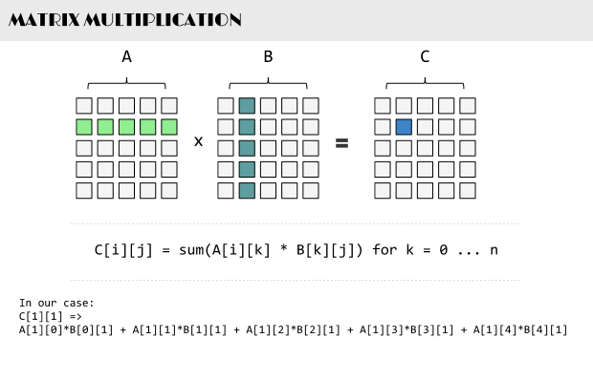

Matrix Multiplication
Matrix multiplication is one of the most important operations in machine learning
Matrix multiplication or matrix product is a binary operation that produces a matrix from two matrices

Slide 25
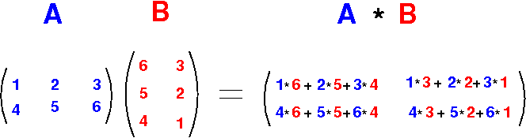
np.matmul
What it does:
Multiplies two matrices
Syntax:
np.matmul(matrixA, matrixB)
Examples
matrixA = np.array([[1,2,3], [4,5,6]])
matrixB = np.array([[6,3], [5,2], [4,1]])
np.matmul(matrixA, matrixB)

Slide 26
Array placeholders
np.zeros
Creates an array of zeros
np.ones
Creates an array of ones
np.arange
Creates an array of evenly spaced values (step value)
np.linspace
Creates an array of evenly spaced values (number of samples)
np.full
Creates a constant array
np.eye
Creates an identity matrix
np.random.random
Creates an array with random values
np.empty
Creates an empty array

Slide 27

Research!
What is an identity matrix?

Slide 28

Print 101 evenly spaced numbers between 0 and 1 e.g. 0. , 0.01, 0.02, 0.03, 0.04, 0.05, 0.06, 0.07… 0.99, 1.0

Slide 29
Research!
What is the difference between a uniform (0,1) and a normal (mean=0, std=1) random distribution?

Slide 30
Print 100 normally-distributed random numbers (with mean 5 and std 2) e.g. -0.65256786, -0.95186321, 0.02303537, 0.10202595, 1.40009348…

Slide 31
Array attributes
a.shape
Returns the shape of the array
a.ndim
Returns the number of dimensions
a.size
Returns the number of elements
Equal to the product of the shape
a.dtype
Returns the data type of the array

Slide 32
Array aggregates
a.sum()
Returns the sum of the array
a.min()
Returns the minimum of the array
a.max()
Returns the maximum of the array
a.std()
Returns the standard deviation of the array
a.mean()
Returns the mean of the array

Slide 33
Research!
What is the difference between standard deviation and variance?

Slide 34
Research!
What is the difference between mean and median? How do you get the median using NumPy?

Slide 35
Array manipulation
a.T
Returns the transpose of the array
a.flatten()
Flattens an array
a.reshape(shape)
Reshapes an array to another shape
np.concatenate((a1, a2), axis=axis)
Concatenates arrays

Slide 36
Research!
Can you reshape a 4 x 4 array to a 2 x 8 array?
4 x 1 to 4 x 1 x 1?

Slide 37

More functions
np.exp
np.sqrt
np.sin
np.cos
np.log
…and many more!

Slide 38
NumPy Inputs and Outputs
np.save('array', a)
Saves an array to an NPY file
np.load('array.npy')
Loads an NPY file
np.savetxt('array.txt', a)
Saves an array to a text file (space-delimited)
np.loadtxt('array.txt')
Loads an array from a text file (space-delimited)
np.savetxt('array.csv', a, delimiter=',')
Saves an array to a CSV file
np.loadtxt('array.csv', delimiter=',')
Loads an array from a CSV file
data = np.loadtxt('loan_approval.csv', delimiter=',').astype(int)

Slide 39
Research!
What is an NPY file?

Slide 40
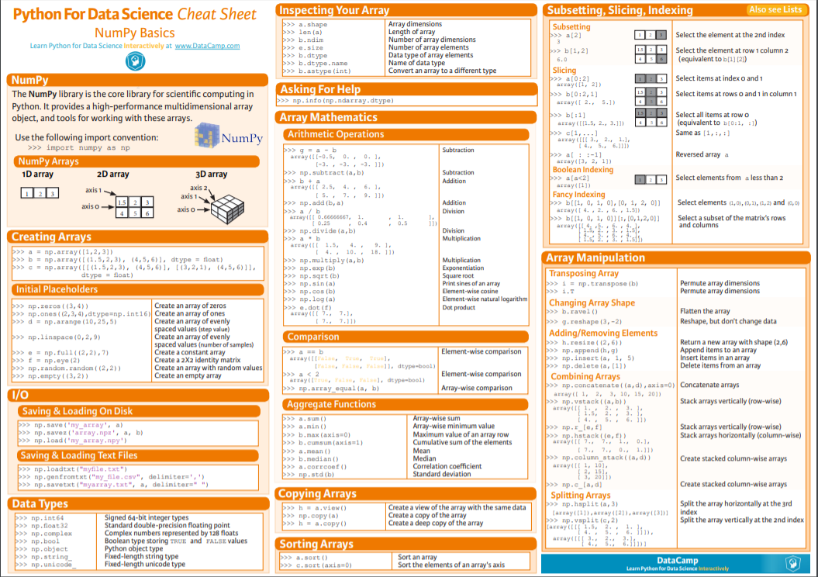
NumPy Cheatsheet Download here: https://s3.amazonaws.com/assets.datacamp.com/blog_assets/Numpy_Python_Cheat_Sheet.pdf

Slide 41
Real-world NumPy

Slide 42

Scenario: Loan approval
You are a DATA SCIENTIST working for a big banking firm
Your colleague, a senior loan officer, wants to select his approvals with more analytical intelligence
After a week of brainstorming, you and your team have predicted the following business rules for approval to yield the best net income for the company.
A client's loan request can only be approved if he/she:
has a current income greater than or equal to 1000 USD per month
has had a mean income greater than or equal to 1000 USD for the last six months
has never lived in the extremely low-income suburb (suburb_id=5)
Download the data here
NOTES:
Column 0 is 'client_id'
Column 1 is 'month'
Column 2 is 'suburb_id'
Column 3 is 'income'
Current month is 24; to get last six months, get average from month 19 till month 24
There are several rows per client; use the client_id to identify the client
Use loops as needed
Task 1: Use slicing and aggregation to find out which clients pass for approval
Task 2: Use the shape attribute to find out how many clients are approved
Bonus: Save the data of the clients who were approved into a CSV and NPY file (for all months)

Slide 43
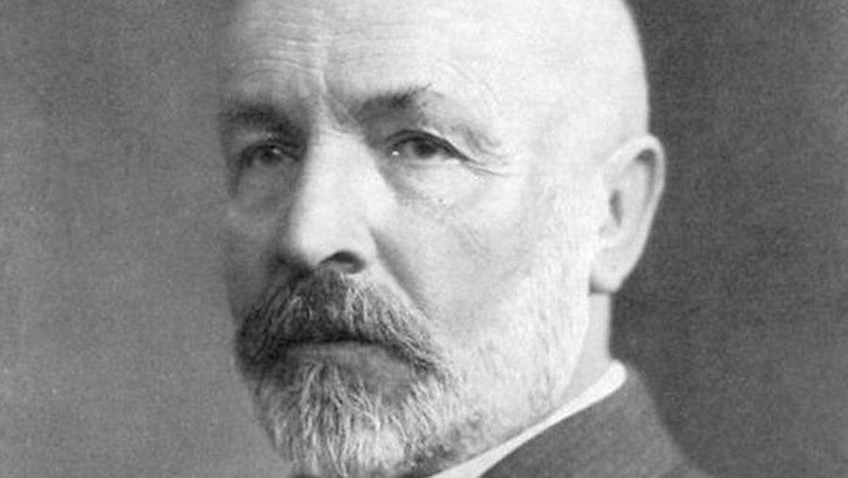
The essence of mathematics lies in its freedom.
Georg Cantor

